Slide 1
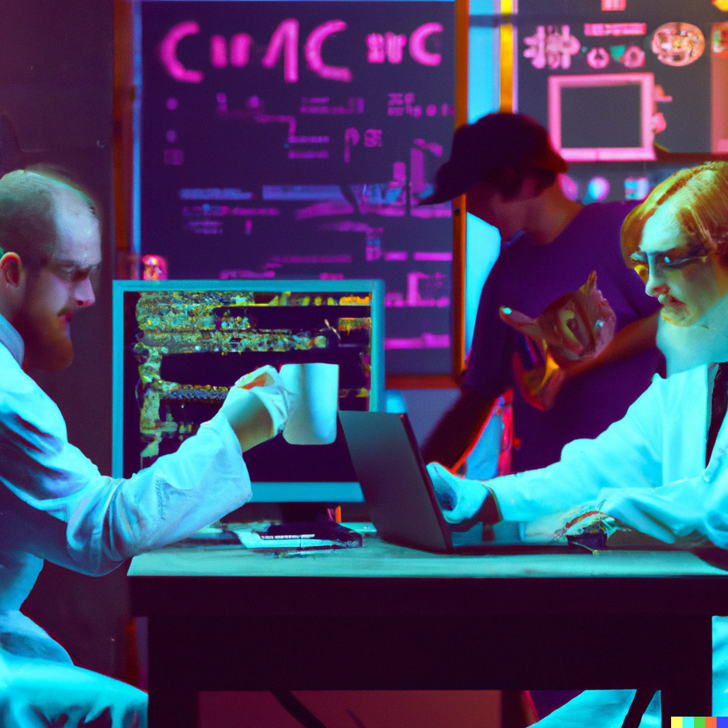
Scientific Computing Student Club
Club meetings once a month with many more activities in between!

Slide 2

Trivia
How to play
Team up and pick a team name
Grab supplies (answer cards, team sheet, pen/pencil)
Turn in a card for every answer with team name on it
Team Names
Alpha
Gamma
A
B
?
Questions
5 questions worth 2 points
1 bonus question based on wager
I will tell you bonus question category

Slide 3
Trivia Question 1
Who invented MATLAB based on their PhD thesis in the 1960’s?

Slide 4
Trivia Question 2
The Library “Basic Linear Algebra Subroutines” is written in what language?
Javascript
Rust
Fortran

Slide 5
Trivia Question 3
What is the name of the most powerful supercomputer according to the High-performance LINPACK benchmark?

Slide 6
Trivia Question 4
Originally developed to analyze nuclear fuel rod assemblies and distributed using the CDC’s Cybernet service, Abaqus is a simulation tool for which analysis methods?

Slide 7
Trivia Question 5
In a QR decomposition $A=QR$, which matrix has orthogonal columns?

Slide 8
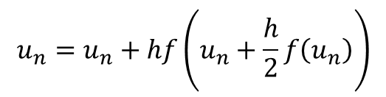

Bonus Question
Fourth Order Runge-Kutta:
$$u_{n}=u_{n}+h\left(k_{1}+{2k}_{2}+2k_{3}+k_{4}\right)$$
Forward Euler:
$$u_{n}=u_{n}+hf\left(u_{n}\right)$$
3 step Adams-Bashforth:
$$u_{n}=u_{n}+h\left(β_{0}f\left(u_{n}\right)+β_{1}f\left(u_{n−1}\right)+β_{2}f\left(u_{n−2}\right)\right)$$
$$u_{n}=u_{n}+hf\left(u_{n}+\frac{h}{2}f\left(u_{n}\right)\right)$$
Midpoint Method:
Rank these numerical methods for solving differential equations by their global accuracy (most to least accurate)

Slide 9
Workshop
SSH and Git
the basics

Slide 10

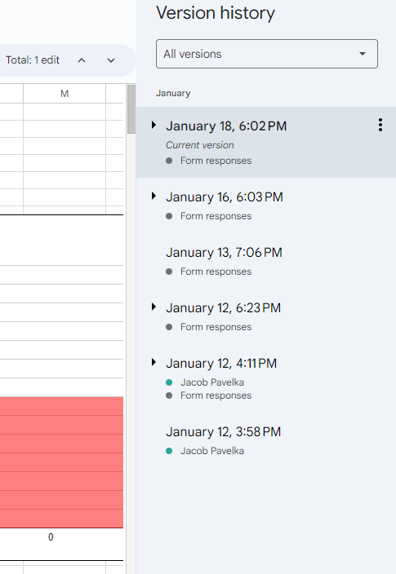
git
Saved
Staged
Untracked
A (mostly) terminal-based version control system
commit
add
Commit_1
hw1
commit
add
Commit_2
hw1
hw2
hw2

Slide 11



SSH
SSH: Secure Shell Protocol
Allows you to securely connect to a terminal remotely
SSH
SSH

Slide 12

Remotes
demo_repository
SSH
Remote add
Clone
Remote add
demo
demo_repository

Slide 13
Branches
Main Branch
HW3 Branch
commit
add
hw1
Commit_1
commit
add
commit
add
hw1
hw2
hw2
hw1
hw3
hw3
Commit_2
Commit_3

Slide 14
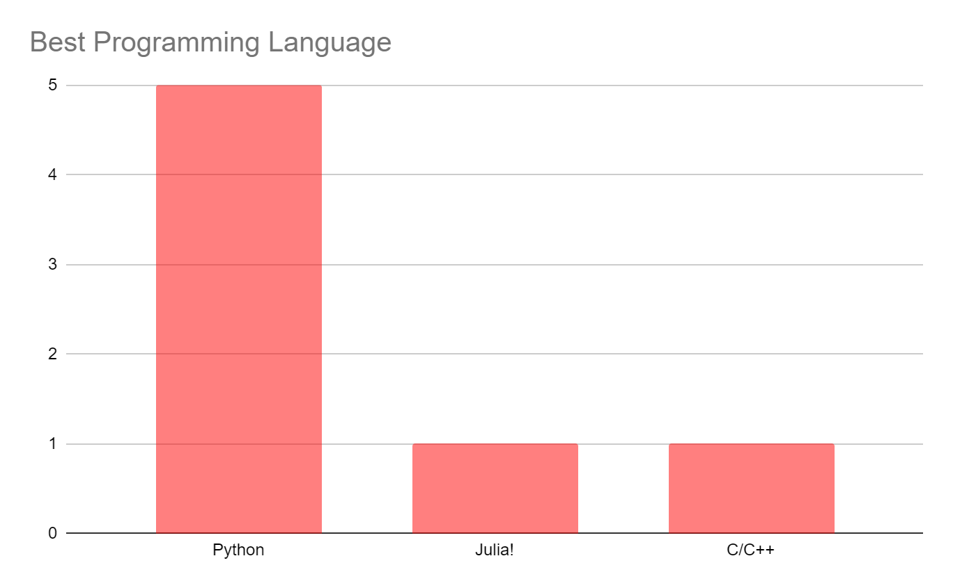
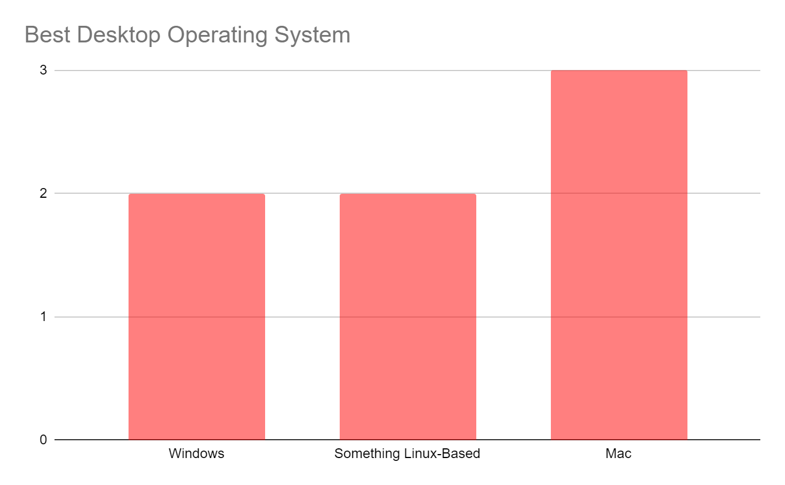
Poll Results:

Slide 15
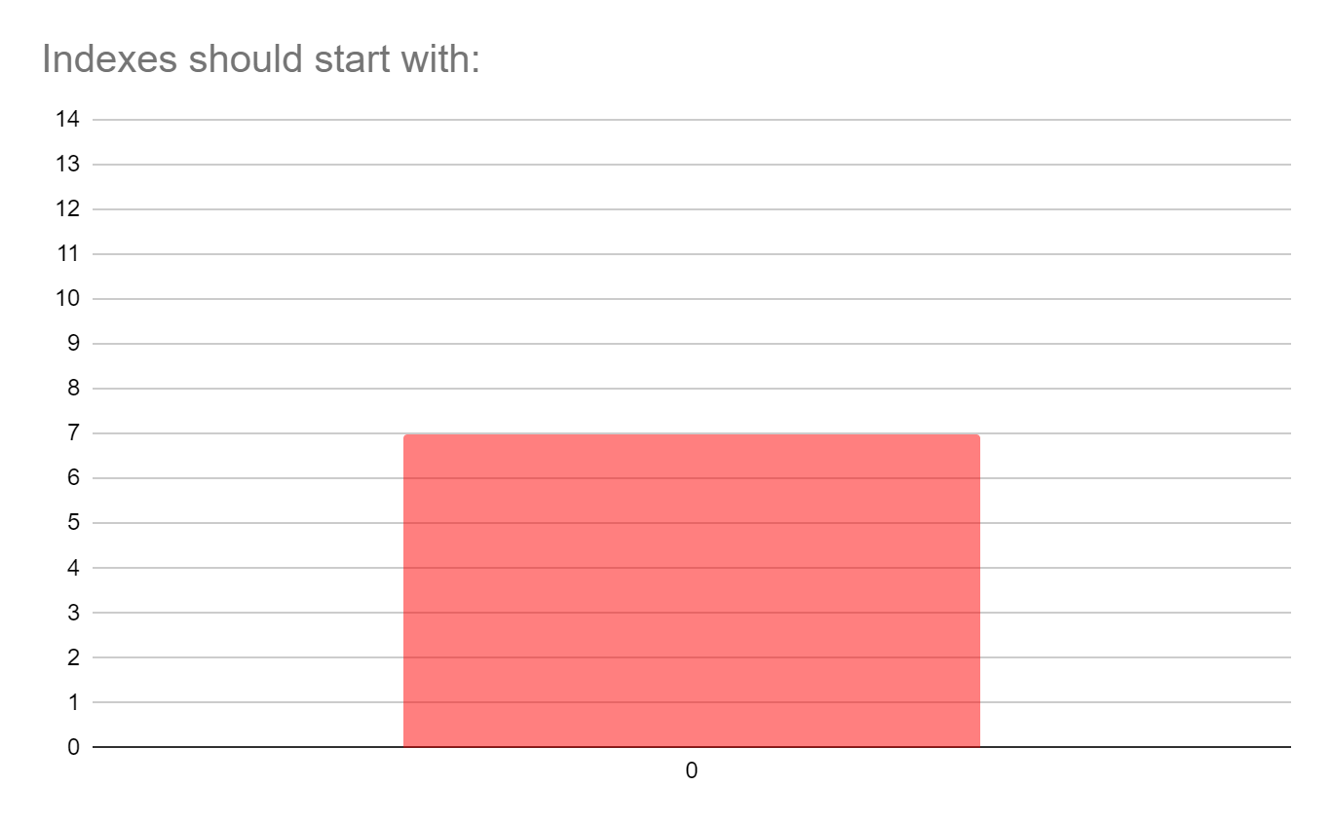
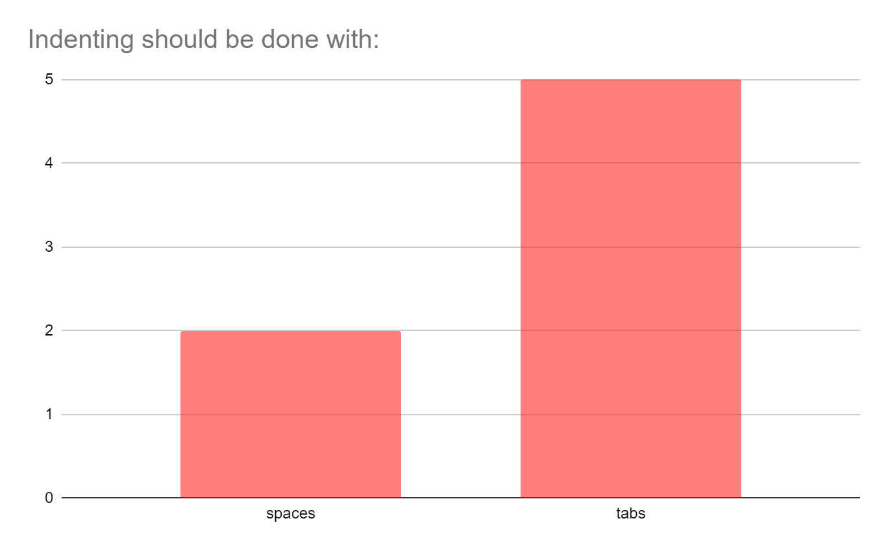
Poll Results:

Slide 16
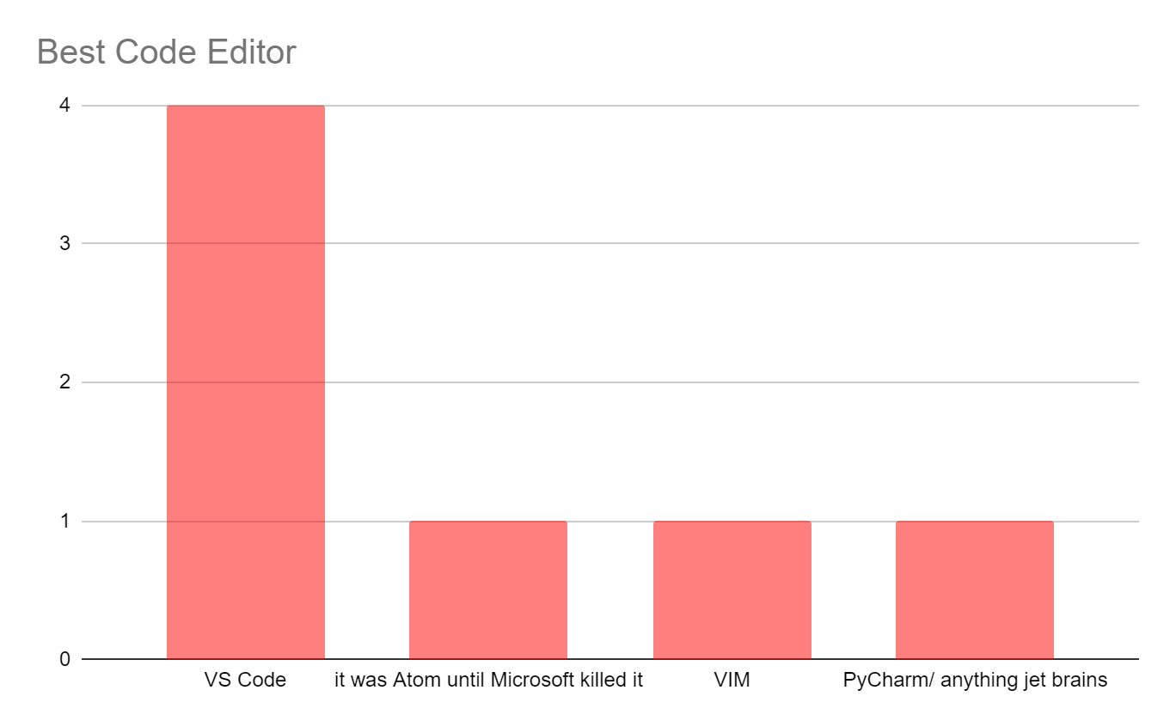
Poll Results:

Slide 17
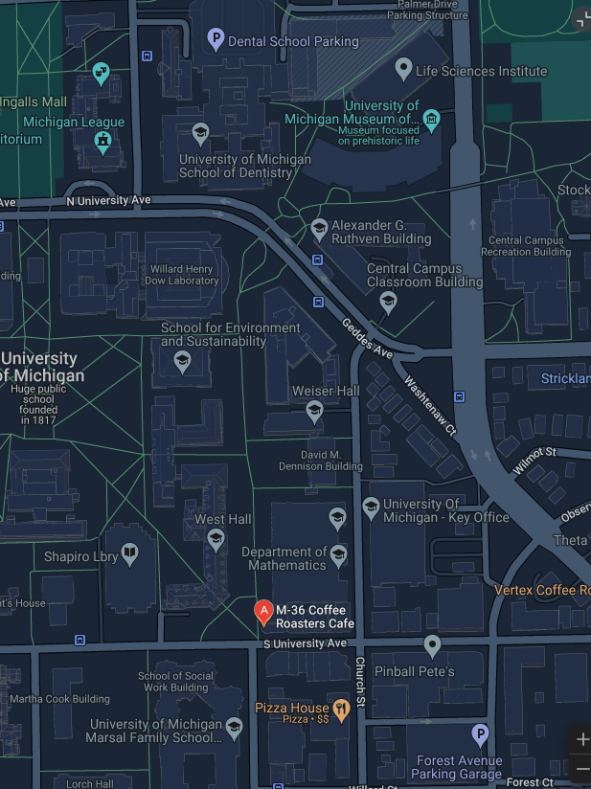
Coffee Social Hour
Where: M36 Roasters (Central Campus)
1101 S. University Ave
When: Every Tue 10-11am
What:
We buy you coffee
Hang out or work if you wish
Ask questions about the club

Slide 18
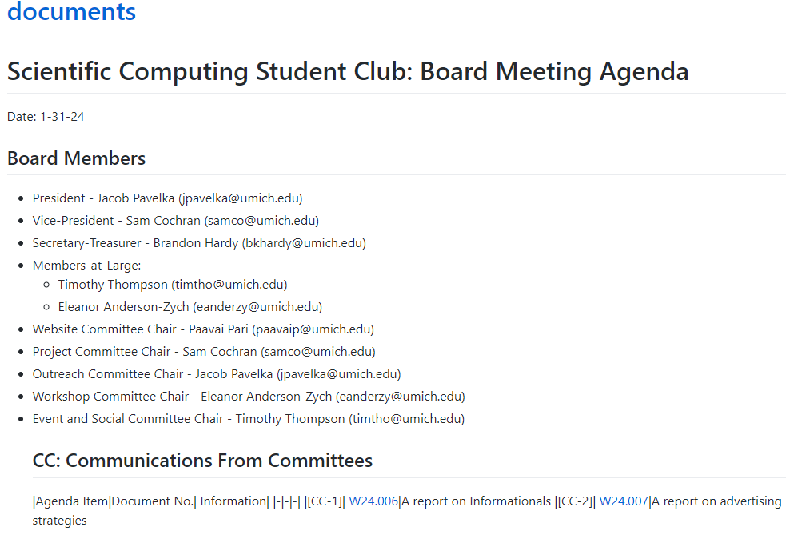
Document Github Repo
https://github.com/sc2umich/documents
https://sc2umich.github.io/documents/
View
Constitution
Project documents
Meeting agendas
And More!

Slide 19
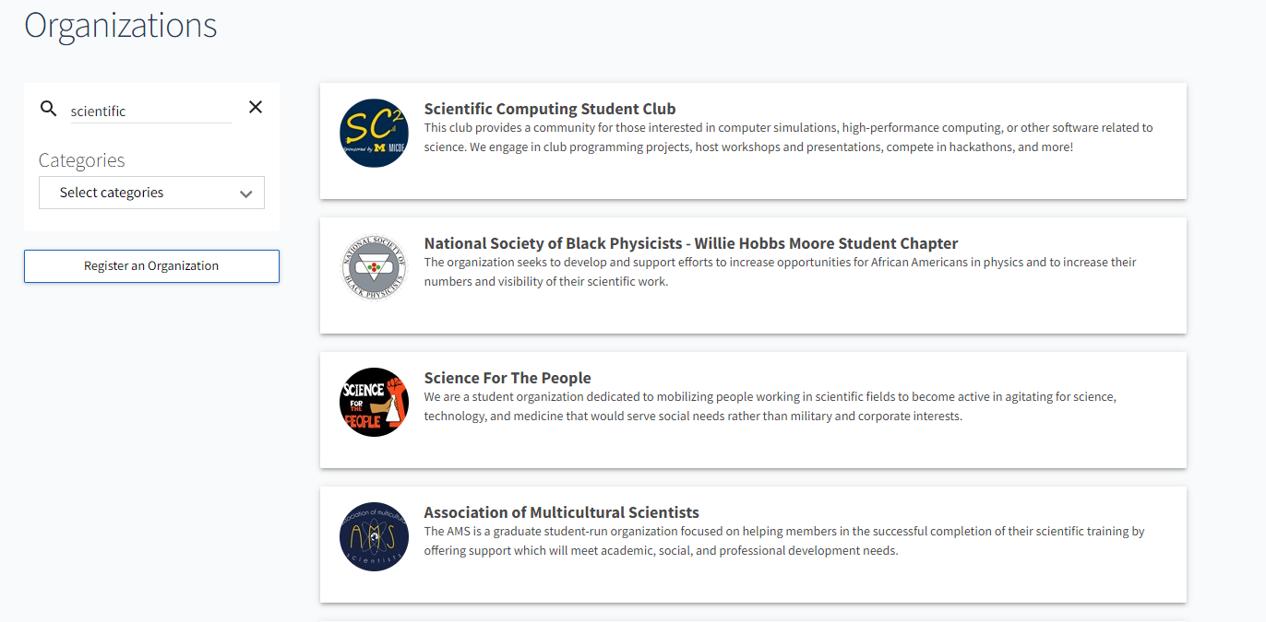
Official SSO and COE Status
We are official now!
Make sure to officially register on maize pages

Slide 20
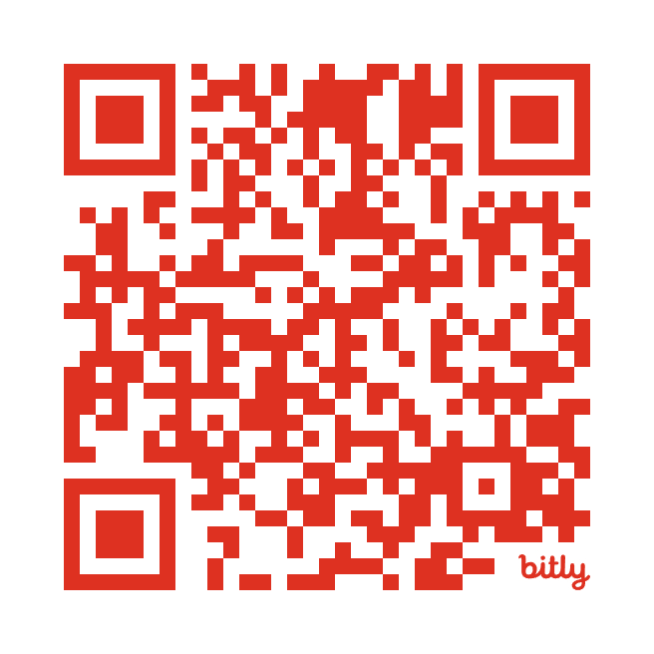
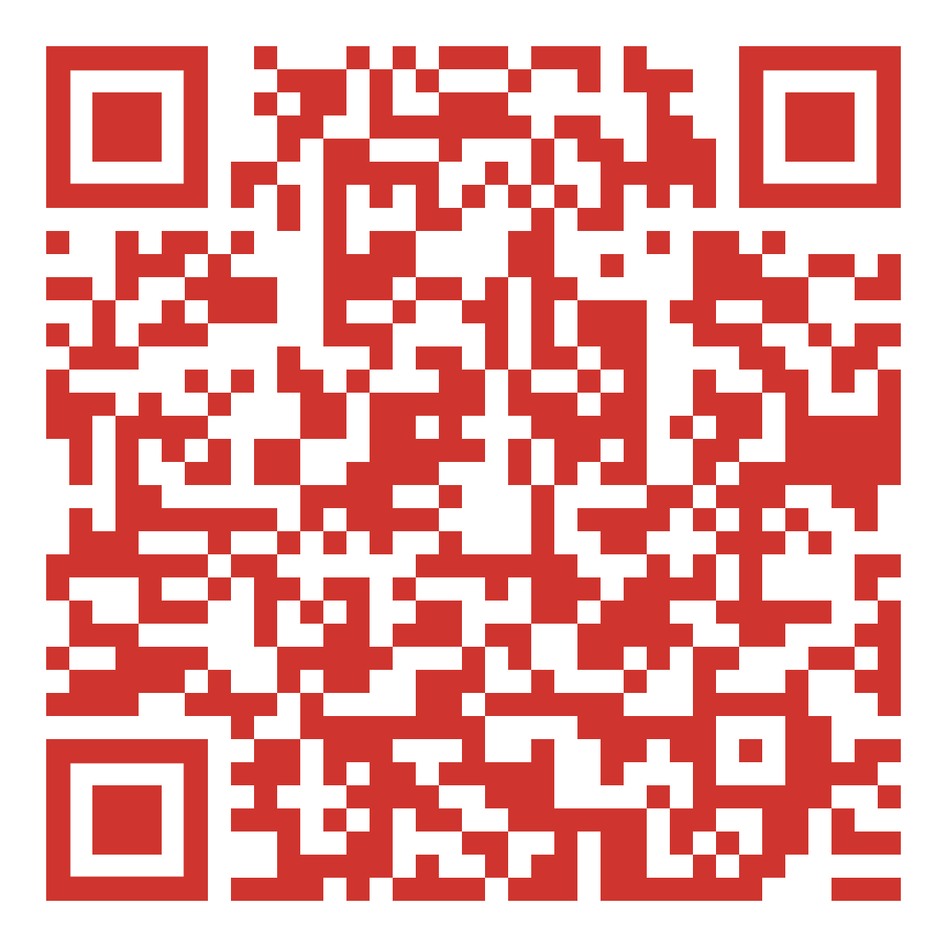
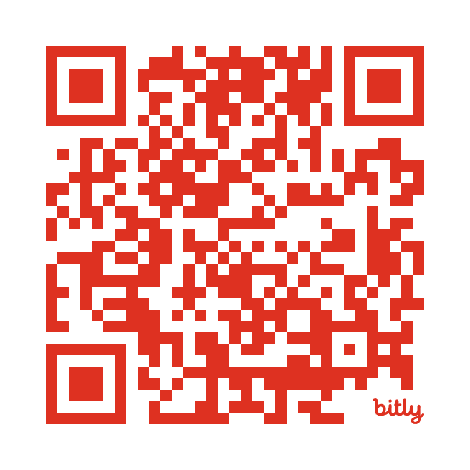

Resources
Join the Club
Project Proposal Example
Submit Workshop Idea
Our Website
Email sc2-officers@umich.edu if you want to submit a project proposal, want to form a competition team, or if you have any questions!

